Slide 1
CS6004 Week 5 – OOP Advanced
Dr. Rattapol Kasemrat
London Metropolitan University

Slide 2
What's OOP Again?
Think of OOP as designing real-world objects in code.
Example: A Car has properties (color, speed) and actions (drive, stop).

Slide 3
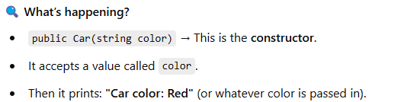
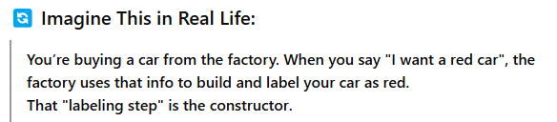
Constructors Made Easy
A constructor sets up an object.
Think of it like the "setup instructions" when you're building a LEGO set.
Every time you build a new car (object), the instructions (constructor) tell it how to start.
Example:
Car myCar = new Car("Red");
Code:
class Car {
public Car(string color) {
Console.WriteLine("Car color: " + color);
}
}

Slide 4

Properties: Smart Get/Set
Properties help control access to data.
You have a box (class) that stores your name but you don’t want anyone to just grab or change it freely — so you give them clever ways to read or write it. That’s what properties do!
Example
public class Student
{
public string Name { get; set; }
}
How Do You Use It?
Student s = new Student();
s.Name = "Rattapol"; // using set
Console.WriteLine(s.Name); // using get

Slide 5
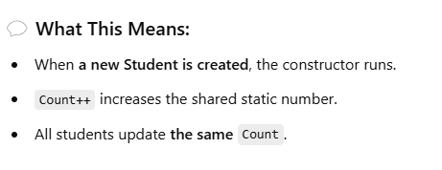
Static Members: Shared by All
Imagine every student gets their student ID (that’s normal data). However, there is one counter on the wall that counts the number of students in the class. That counter is static — shared by everyone.
class Student
{
public static int Count = 0;
public Student()
{
Count++;
}
}

Slide 6
Abstract Classes
Let’s say we’re creating a system to represent different types of vehicles.
We know every vehicle can start, but how it starts depends on the vehicle type.
We’ll use an abstract class to define the common rule — “every vehicle must start.”
class Car : Vehicle
{
public override void Start()
{
Console.WriteLine("Starting the car with a key.");
}
}
class ElectricScooter : Vehicle
{
public override void Start()
{
Console.WriteLine("Starting the scooter with a button.");
}
}
Vehicle v1 = new Car();
Vehicle v2 = new ElectricScooter();
v1.Start(); // Output: Starting the car with a key.
v2.Start(); // Output: Starting the scooter with a button.

Slide 7
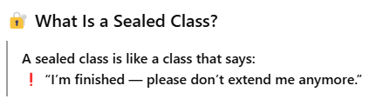
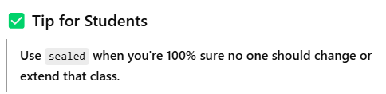
Sealed Classes
Think of it like a final version of a document that’s been locked as a PDF. You can still use it, read it, and send it around — but you can’t change it or add anything to it.
sealed class PaymentProcessor
{
public void Process()
{
Console.WriteLine("Payment processed.");
}
}

Slide 8
Casting
🔍 Imagine This:
You have a class called Person and a class called Student that inherits from Person:
class Person { }
class Student : Person
{
public void Study()
{
Console.WriteLine("Student is studying...");
}
}

Slide 9

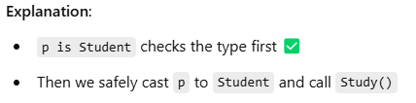
Example 1 : using is
Person p = new Student(); // Looks like a Person, but it's actually a Student
if (p is Student)
{
Student s = (Student)p; // Safe cast
s.Study(); // Output: Student is studying...
}

Slide 10
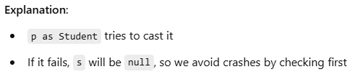
Example 2 : using as
Person p = new Student();
Student s = p as Student;
if (s != null)
{
s.Study(); // Output: Student is studying...
}

Slide 11
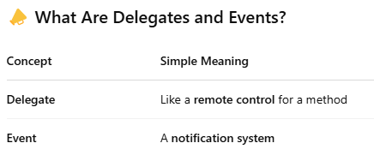
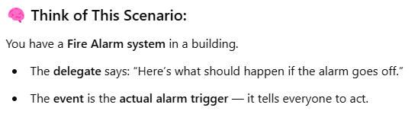
Delegates and Events

Slide 12
Code Example – Step by Step
Step 1: Create a Delegate
delegate void Alert(); // Defines a delegate that can point to any method with "void Name()" signature
Step 2: Create an Event
class AlarmSystem
{
public event Alert OnAlarm; // Event based on the Alert delegate
public void TriggerAlarm()
{
Console.WriteLine("🔔 Alarm triggered!"); // Inform that the alarm has been triggered
OnAlarm?.Invoke(); // If there are any subscribers, notify them
}
}
Step 3: Subscribe to the Event

Slide 13
class Program
{
static void Main()
{
AlarmSystem alarm = new AlarmSystem(); // Create a new AlarmSystem object
// Subscribe methods to the event
alarm.OnAlarm += SendText; // Add SendText method to the OnAlarm event
alarm.OnAlarm += CallSecurity; // Add CallSecurity method to the OnAlarm event
alarm.TriggerAlarm(); // Trigger the alarm, which notifies all subscribers
}
static void SendText()
{
Console.WriteLine("📲 Sending text alert..."); // Simulates sending a text message
}
static void CallSecurity()
{
Console.WriteLine("🚓 Calling security..."); // Simulates calling security
}
}
🔔 Alarm triggered!
📱 Sending text alert...
🚓 Calling security...

Slide 14
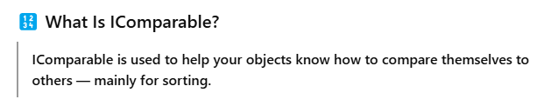
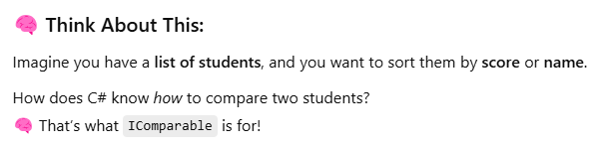
IComparable

Slide 15
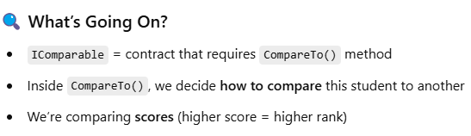
Step 1: Create the student Class
using System;
using System.Collections.Generic;
class Student : IComparable
{
public string Name { get; set; } // Student name
public int Score { get; set; } // Score to compare
// CompareTo helps decide how to sort this object compared to another
public int CompareTo(object obj)
{
Student other = obj as Student; // Try to convert the object to Student
if (other == null)
return 0; // If it’s not a student, return 0 (equal)
return this.Score.CompareTo(other.Score); // Compare scores (low to high)
}
}

Slide 16
✅ Usage Example
class Program
{
static void Main()
{
List<Student> students = new List<Student>
{
new Student { Name = "Alice", Score = 85 },
new Student { Name = "Bob", Score = 92 },
new Student { Name = "Charlie", Score = 78 }
};
students.Sort(); // Uses CompareTo to sort the list
foreach (Student s in students)
{
Console.WriteLine($"{s.Name} - {s.Score}"); // Show sorted students
}
}
}
✅ Output:
Bob - 95
Alice - 85
Charlie - 75

Slide 17
Summary - You Got This!
Constructors = setup your object
Properties = smart variables
Static = shared
Abstract = base class
Sealed = locked class
is/as = safe type check
Events = react to changes

